Slide 1


Eco-Bricks & its Diverse Value
Prepared for: Ecobricks.org
Prepared by: Ayandeep Kundu, Think Pacific Intern 2nd Aug’21
Proposal Aim: Ecobricks and its massive diverse values

Slide 2

Chapters:
Chapter 1. Ecobricks in Environmental uses and its positive impact
Chapter 2. Ecobricks in Innovation
Chapter 3. Ecobricks helping Wellness Fiji

Slide 3

Eco-Bricks in Environmental Use

Slide 4
Eco-bricks Decorating Environment:
Eco-bricks can used in various kinds of decoration including environment and domestic arenas.
Ecobricks placed in sea shores 2/3rd deep into soil can prevent Soil Erosion during Flooding.
Ecobricks are better choice for building Fence around crop-field or House as well.
Ecobricks are already in use making walls and this is cheaper than clay-bricks

Slide 5
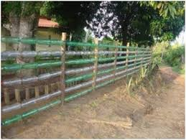
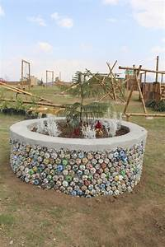
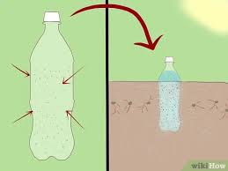
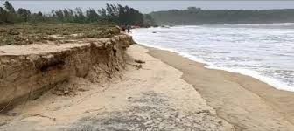
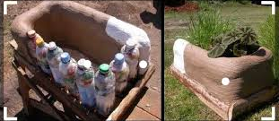
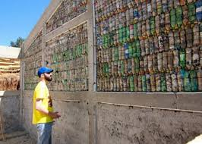
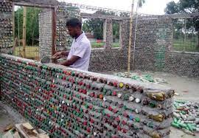
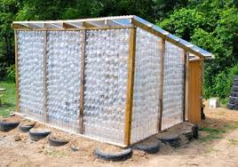
Eco brick preventing
Soil Erosion
Eco brick Fence
Eco bricks Wall

Slide 6
Eco-bricks in Public Places:

Slide 7
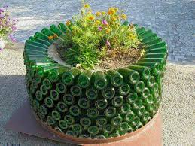
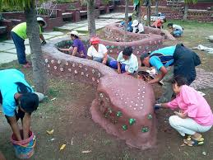
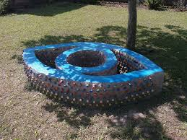
Eco bricks are very good elements to decorate Nature
Eco bricks in Park
Plant Decoration
Riders / Interesting Structures

Slide 8
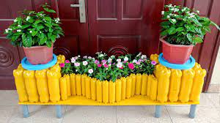
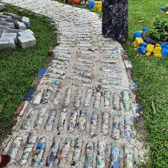
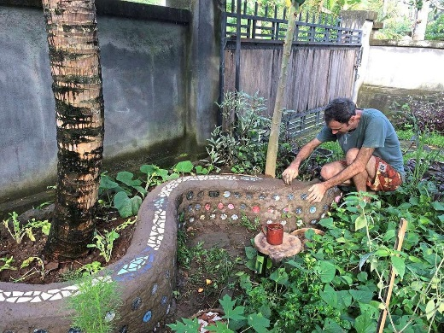
Eco bricks in Gardening
Eco-bricks are Useful in garden decoration in many ways as follows:
Domestic Planting
Eco brick foot-path
Eco brick Fencing

Slide 9
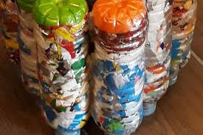
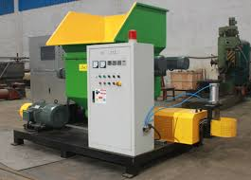
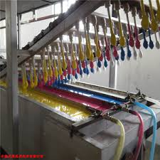
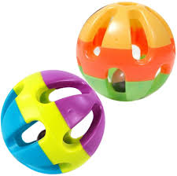
Eco-bricks in Toy making:
Plastic from eco bricks
Extracted PLASTIC MELTS
Plastic Toys
Toy Maker

Slide 10
Eco-bricks in Domestic Use:

Slide 11
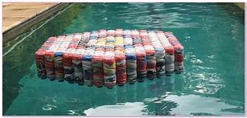
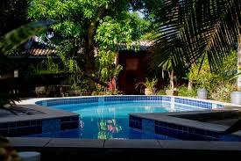
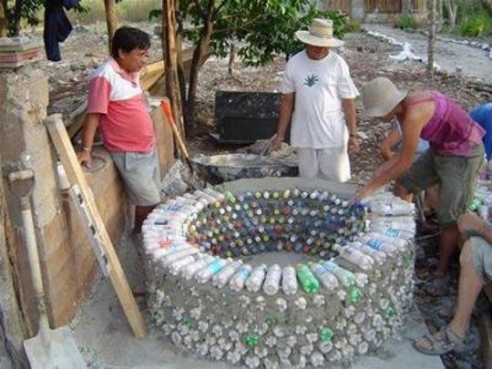
Eco-bricks in Domestic Use:
Eco brick water pool
Eco-bricks can float in water.
Hence this can be used to make floating surface in swimming pool.
Even a pool or water tank made of Eco bricks is possible.

Slide 12
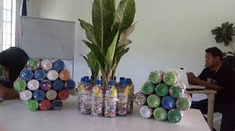
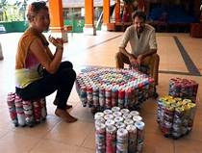
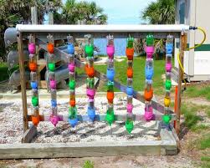
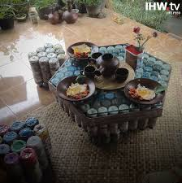
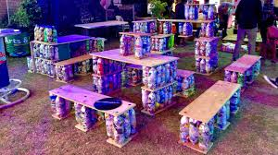
Sophisticated items
Eco-bricks can be helpful making chairs and tables and other sophisticated things: Eco brick Bench, table, sofa, and many more interesting things etc.
Eco bricks used being sophisticated items

Slide 13
Positive Impact of Eco-bricks in Environment:

Slide 14
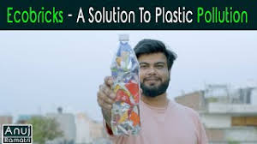
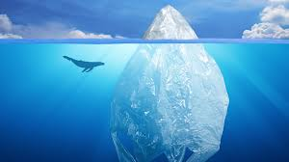
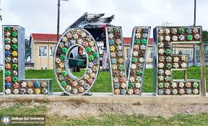
It will reduce plastic pollution​.
Ecobricks can enhance plastic up cycling.​
Animal and marine livings are being affected by this plastic; it will help nature Recover and be Decorative.​
Urge of cutting Trees for fibre and wood can be reduced.
Woods can be used for better work​.
Nicer and Sustainable Environment.

Slide 15

Eco-Bricks in Innovation

Slide 16
Eco-brick Boats(canoe)
PEOPLE can sail in the river making a large surface made of ECO-BRICKS.
The plastics put inside the eco bricks are low density plastics which are floatable in water and because of this Eco bricks are able to Float. (Density of Plastic used: ¬940 kg/m3 & Density of water : 997 kg/m3)
Therefore, instead of making the hull made of metal or synthetic fibre Eco bricks can be a very good replacement and the most interesting thing is that anyone can go for sailing in river with just making few Eco bricks put together.
There are several benefits of using this kind of boat and those are –
Eco-friendly, free of fibre and plastic.
Easy to make and cost effective
Portable (one can take it home and come back to river to use)
Really a good idea to teach young people how to swim and indulge them in a creative way can make their thoughts and free time better in perspective of mental as well as physical health.
Best for fishing as fishes get attracted towards colourful objects.

Slide 17

Structure showcase
Illustration of the Structure
single pattern for bottom surface
Bottom surface is tied up with the upper surface to make the whole boat ready for sailing.
Bottom surface
single pattern for bottom surface
Upper surface

Slide 18
Floating Bridge
Eco bricks can contribute towards Namosi eco-retreat project.
Eco bricks arranged in a linear pattern and connected together with strong rope or wire can make a bridge in a river for transportation.
Arrangements Description of Eco-bricks making the Bridge:-
The bridge will be formed with 2 layers: Bottom and Top layer.
In the bottom layer made of Eco bricks will be aligned with an axis of the width of a river whereas the top layer will consist of a Flat light sheet (hard fibre/plastic) with an axis of the length of the river supporting surface for transport. The brick network gives upward thrust to balance the weight due to transportation, whereas the upper surface will provide means for travelling.
The bottom layer of bricks are supported by two strong ropes from one shore to the other and the rope is supported by a metallic over-head arch attached to both shores.
As the bottom layer is made of bricks connected with each other with rope they rotates as the stream flows imposing less strain towards the bridge and as the upper surface is light weight and directly bound to the rope, it gives extra flexibility to the bridge towards high tide and high water flow.

Slide 19
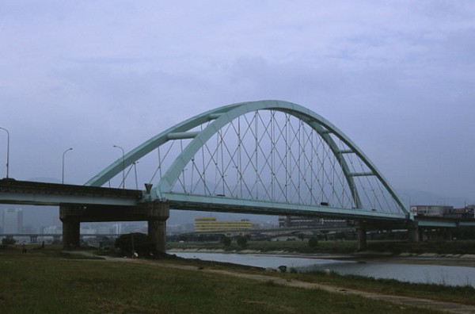
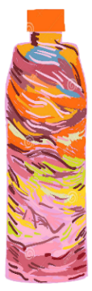
Illustration of the Structure
dummy
Shore
Bottom Layer
Strong cable
Arch cables directly balance the weight imparted on the blocks
Upper Layer and the Arch
Each block supported by the cables

Slide 20
Eco-Bricks Helping Wellness Fiji

Slide 21

Eco-Brick Facilitating Mental Health Initiatives

Slide 22
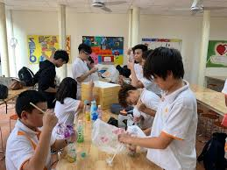
Social and Physical Engagement:
Making Eco-bricks: Introduced as a Extracurricular Activity in school/ colleges.
In this way children as well as adults will get a new interesting way to get them connected to nature as well to people.
This will give them Encouragement to work further and to Carry on.
This will help to Fight with Stigma, the Fijian people face before getting disgraced.

Slide 23


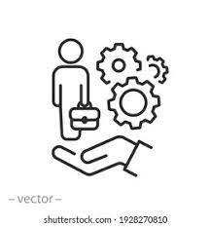
Financial support:
Eco-brick is now a global idea and innovative ideas from adults as well as children can be implemented in real life.
In return they can be benefitted with -
Financial support
Education and
Work placement

Slide 24


Fund raising for Wellness Fiji:
Import-Export of Eco-bricks to its demanding countries: India, US etc. can be-
A good option for making a Funding for Wellness Fiji association
Good relationship with other Countries

Slide 25

Checkout the below website
Eco-brick project helping Wellness Fiji

